Slide 1
Candy Shop Exercise
Python - Lesson 2 – Activity 3
Gustavo Maldonado

Slide 2
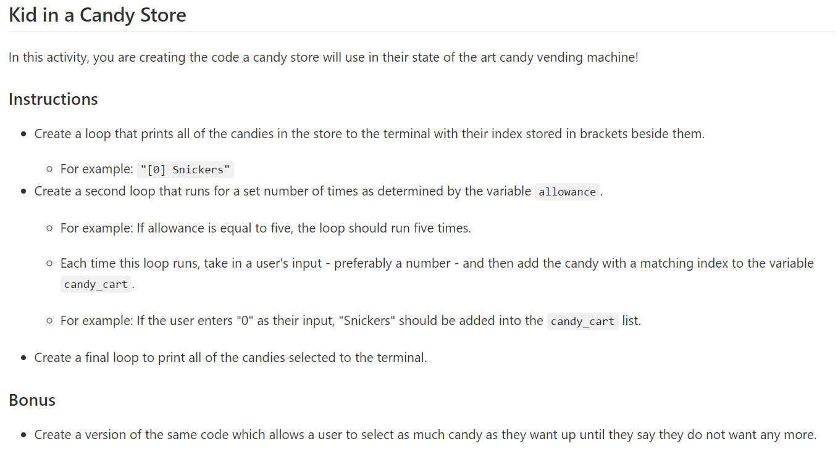
Instructions:

Slide 3
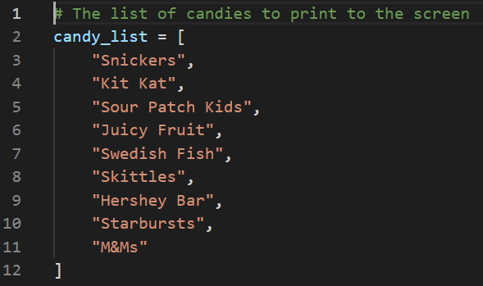
List: are defined by [ ], the order (vertical or horizontal) doesn’t make any difference.
candy_list: define your variable 1 using =.
Always add , at the end of each list, except the last value.
If is a string value (text), add “ ” in between.
Vertical
Horizontal

Slide 4
Define other variables:
allowance: in this case is the number of times the person can chose an option.
Variable 2 define by =.
Numeric parameter as integer, the definition is not needed.
Variable 2
candy_cart: in this variable the option will be storage.
Variable 3 define by =.
The parameter is defined by [ ], because inside of it we are going to storage the chosen options.
Variable 3

Slide 5

For Iteration 1 – Print the list of option using [ ]:
candy: variable 4 used to save the total option in the candy list.
FOR needs IN and : in between the variables.
Candy will contain each of the candies in the candy_list.
2 ways to solve it:
Len function: returns the length of the list (ex. in this case the candy list contains 9, so the range will be 9). Use ( ) to define the parameter.
Range function: returns the range according to the number/variable defined. Use ( ) to define the parameter.
Index function: returns the index of a list.
f’ function: converts the numeric values into string (text). Important requires { } the value to be convert into string. This function does not require , in between the variables/formulas.
Option 1
Option 2

Slide 6
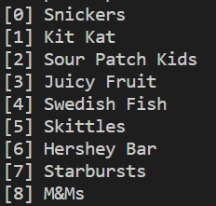


Option 1:
LOOP:
RESULT:
$for candy in candy_list$:
PRINT:
$$print(f^{′}\left[\left\{str\left(candy_list.index\left(candy\right)\right)\right\}\right] \left\{candy\right\}´)$$
$$print(f^{′}\left[\left\{str\left(candy_list.index\left(9\right)\right)\right\}\right] \left\{9\right\}´)$$
$$print(f^{′}\left[\left\{str\left(\left(9\right)\right)\right\}\right] \left\{9\right\}´)$$
$$print([0]+Snickers)$$
*I recommend to remove the str, the f’ already does the string.

Slide 7
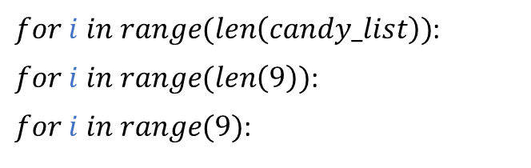

Option 2:
LOOP:
RESULT:
$for i in range(len\left(candy_list\right))$:
$for i in range(len\left(9\right))$:
$for i in range(9)$:
PRINT:
$$print{\left(′[^{′} +str\left(i\right){+ }^{′}\right]}^{′}+candy_list[i])$$
$$print(′[str\left(i\right)]′+candy_list[i])$$
$$print(′[str\left(0\right)]′+candy_list[0])$$
$$print([0]+Snickers)$$

Slide 8
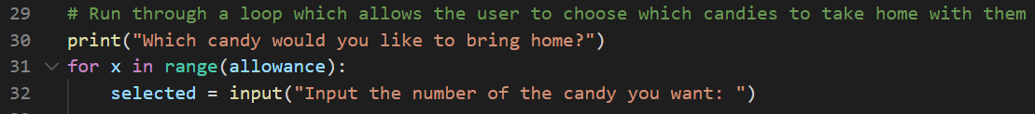
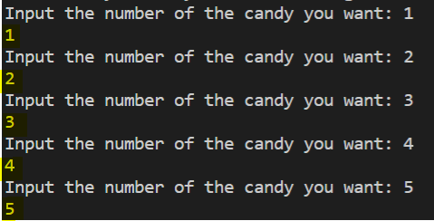
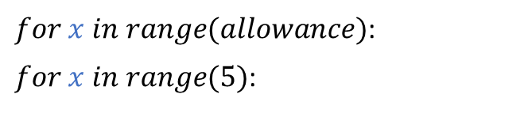
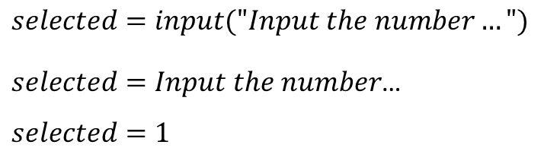
For Iteration 2 – Ask for the options:
selected: variable 5, it will help to allocate the chosen options.
LOOP:
RESULT:
$for x in range(allowance)$:
$for x in range(5)$:
DEFINE VAR & ASK INPUT:
$$selected=input("Input the number…")$$
$selected=Input the number$…
$$selected=1$$

Slide 9
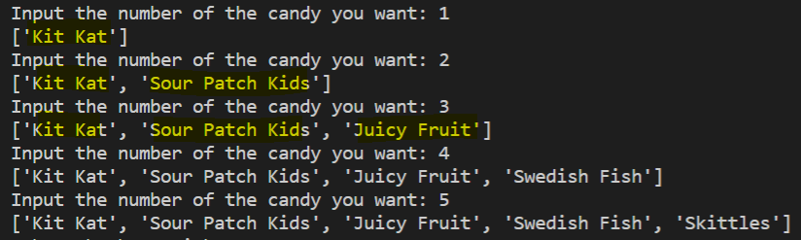

Append or Concatenate the options:
Use variable 2, candy_cart [ ] to save the options obtained in the input.
append fucntion: requires previous define variable, also . in between and ().
APPEND:
RESULT:
$$candy_cart.append(candy_list[int(selected)])$$
$$candy_cart.append(candy_list[int(1)])$$
$$candy_cart.append(candy_list[int(2)])$$
$$candy_cart["Kit Kat","Juicy Fruit",…]$$
*Saves the input as list because of [ ]

Slide 10
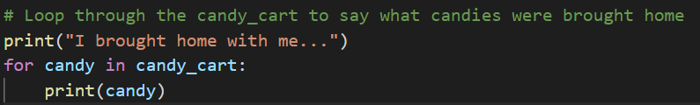
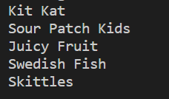

Print the options using a For Iteration:
Using for, the print shows 1 by 1 from data save in candy_cart.
FOR:
RESULT:
$for candy in candy_cart$:
$$print\left(candy\right)$$
$$\# print candy_cart options 1 by 1.$$
*The variable “candy” is not linked to the first candy; it just helps to as variable to print.

Slide 11
BONUS

Slide 12
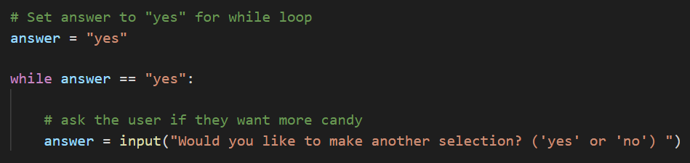
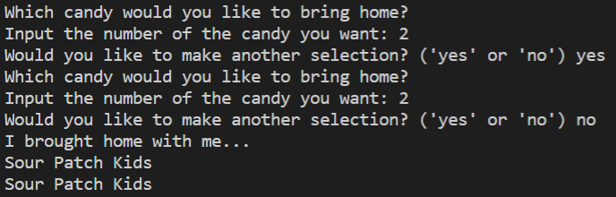
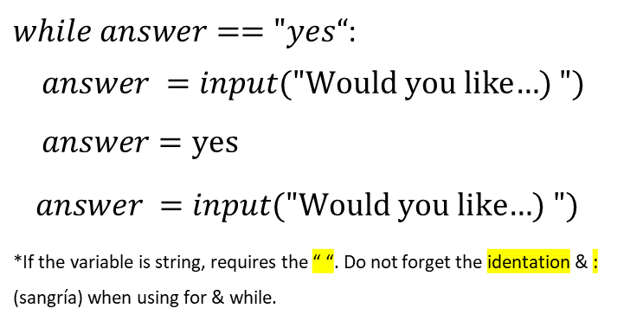
While – Ask how many candies the person wants:
answer: variable 6, set as “yes” for asking the user if the want an extra candy.
while: the iteration occurs while the parameter is met.
allowance variable is removed by the while and also the for.
DEFINE VAR & ASK INPUT:
RESULT:
$while answer=="yes“$:
$$answer =input(\text{"}\text{Would} \text{you} \text{like}\text{…) }")$$
$$answer=\text{yes}$$
$answer =input(\text{"}\text{Would} \text{you} \text{like}\text{…) }")$
*If the variable is string, requires the “ “. Do not forget the identation & : (sangría) when using for & while.

